Slide 1
Preview
Presented by :Deepak chaudhary year/sem :4rd/8th
Roll no : 21EELCS013

Slide 2
Content
This slide help us to know the further content present in the ppt
S.NO | TOPICS
1 | Introduction
2 | Timeline
3 | Problem statement
4 | project objectives
5 | Methodology
6 | Project
7 | Conclusion
8 | References

Slide 3
01
INTRODUCTION

Slide 4
Introduction
This project focuses on developing an AI-powered Voice Agent for the education sector.
It utilizes advanced technologies like Next.js, React, Tailwind CSS, Convex, and AssemblyAI.
The system provides real-time speech recognition, interactive voice responses, and AI-powered assistance.
Aims to enhance digital learning, virtual tutoring, and student engagement.
Demonstrates how voice-enabled AI can revolutionize e-learning by making education more interactive and accessible.

Slide 5
02
Timeline

Slide 6
(March-April)
WEEK 1
PLANNING
WEEK 2
WEB PAGE DESIGNING
WEEK 3
FRONTEND
WEEK 4
BACKEND
WEEK 5
API INTEGRATION
WEEK 6
DEPLOYMENT
WEEK 8
PROJECT SUBMITION
WEEK 7
TESTING

Slide 7
03
Problem Statement

Slide 8
Traditional learning methods often lack personalized feedback, real-time interaction, and hands-on practice, making it difficult for students to prepare for interviews and learn new languages effectively.
Limited Real-World Practice: Students struggle to gain practical interview experience and receive constructive feedback.
Lack of Personalized Learning: Generic learning platforms do not adapt to individual needs, hindering language proficiency and communication skills.
Inefficient Assessment & Guidance: Existing tools provide static content rather than interactive and AI-driven evaluations.

Slide 9
04
Project objective

Slide 10
Develop an AI-Powered Voice Agent to simulate real interview scenarios for students.
Enable real-time speech recognition and interactive voice responses for effective communication practice.
Provide AI-driven feedback on pronunciation, fluency, confidence, and language proficiency.
Assist students in learning new languages through interactive AI conversations.
Enhance digital learning by integrating advanced technologies like Next.js, React, Tailwind CSS, Convex, and AssemblyAI.
Create a user-friendly platform that offers a seamless and immersive learning experience.
Improve interview readiness by providing personalized insights and continuous skill enhancement.

Slide 11
05
Methodology /Approach

Slide 12

.
The project follows a structured and technology-driven approach to ensure an efficient and interactive learning experience:
Frontend Development – Developed using Next.js and React to create a highly interactive, fast, and user-friendly interface.
UI Styling & Design – Tailwind CSS is leveraged for a modern, responsive, and easily customizable design.
Backend & Real-Time Data Management – Convex handles real-time database operations, seamless state management, and dynamic data synchronization.
AI-Powered Voice Processing – AssemblyAI enables accurate speech recognition, real-time transcription, and intelligent voice interactions.
Deployment & Scalability – The application is hosted on Vercel, ensuring efficient performance, high availability, and smooth scalability.

Slide 13
06
Project

Slide 14
Features Implemented:
AI-Driven Interview Practice – Simulates real interview scenarios with interactive voice responses.
Language Learning Support – Enables students to practice and improve language skills through AI-powered conversations.
Real-Time Speech Recognition – Uses AssemblyAI to convert speech to text and analyze responses.
Interactive Feedback System – Provides AI-generated insights on fluency, pronunciation, confidence, and correctness.
Responsive User Interface – Designed using Next.js, React, and Tailwind CSS for a seamless and engaging experience.
Tech Stack Used:
Frontend: Next.js, React, Tailwind CSS
Backend & Database: Convex (real-time data handling)
AI & Speech Processing: AssemblyAI
Deployment: Vercel (for seamless hosting and scalability)
Challenges Faced:
Speech Recognition Accuracy – Ensuring precise transcription and context understanding for AI feedback.
Real-Time Processing – Optimizing latency for a smooth, interactive user experience.
Personalized Learning – Implementing adaptive AI feedback to cater to different skill levels.

Slide 15
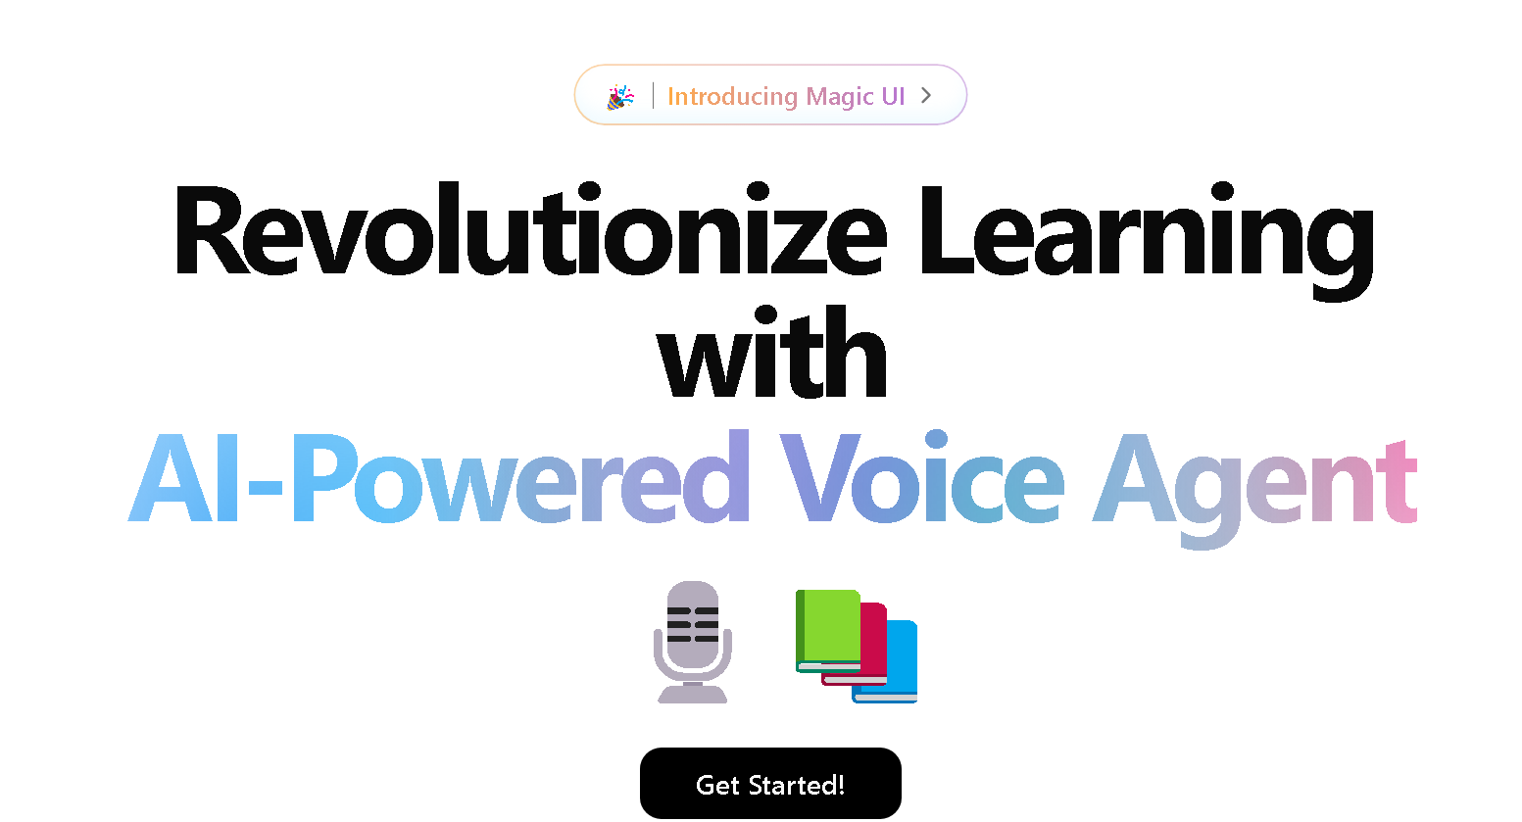
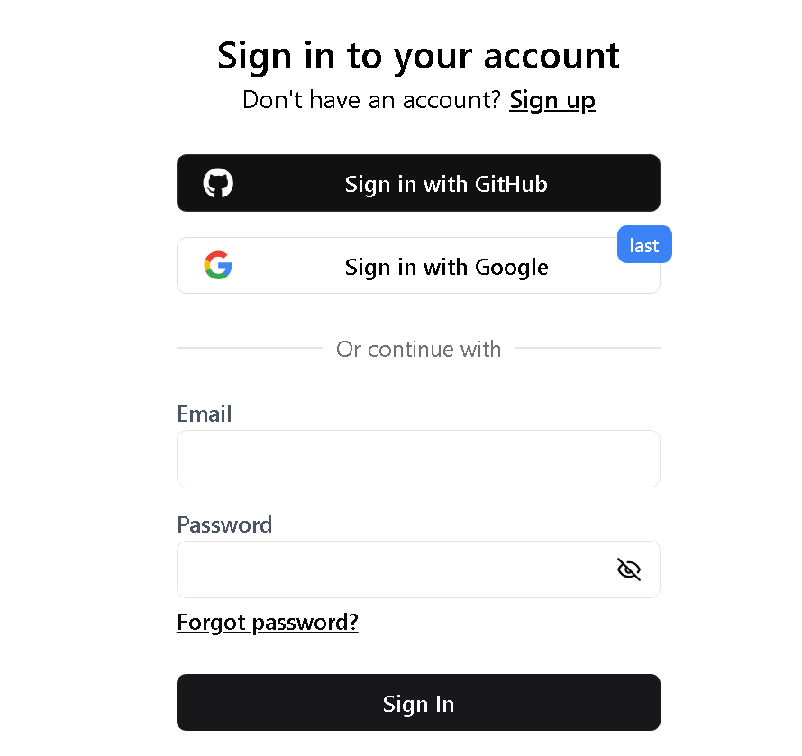
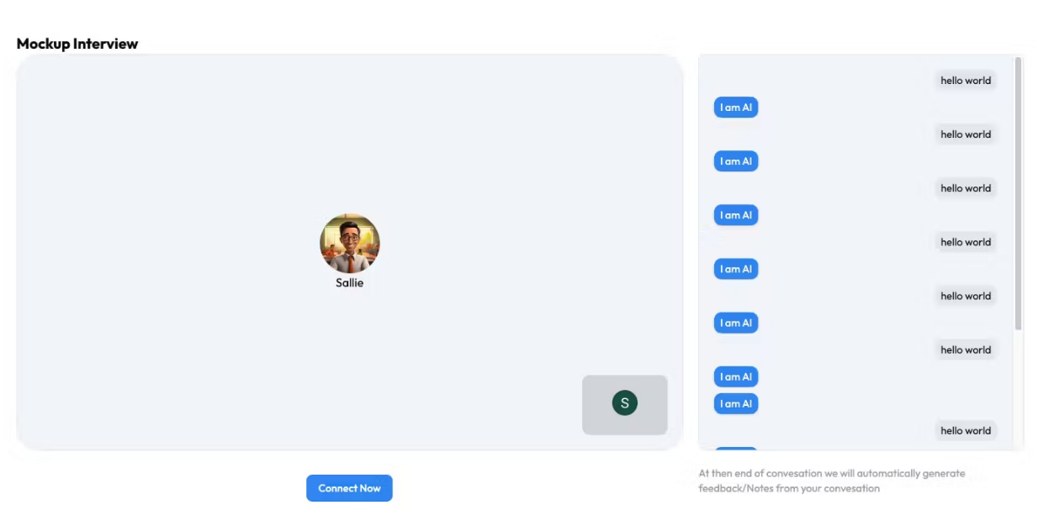
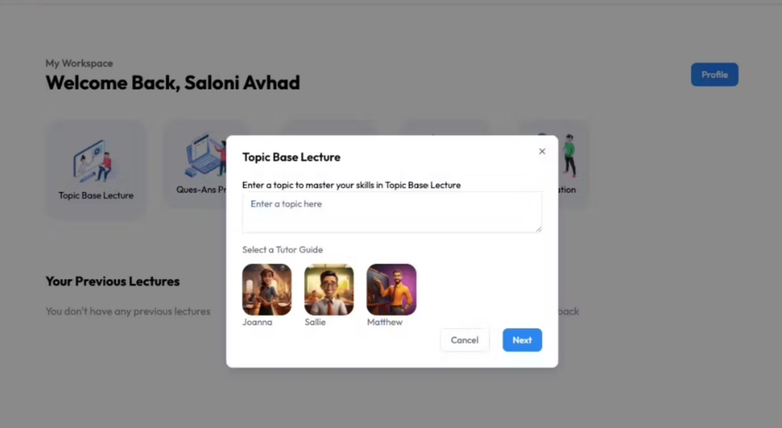
PREPVIEW

Slide 16
07
CONCLUSION

Slide 17
Conclusion
The AI-powered Voice Agent presents an innovative solution for interview preparation and language learning, leveraging real-time speech recognition, AI-driven feedback, and interactive conversations. By integrating Next.js, React, Tailwind CSS, Convex, and AssemblyAI, the platform provides a seamless, engaging, and adaptive learning experience for students.
This project highlights the potential of AI in education, making learning more interactive, accessible, and effective. With further enhancements, the platform can be expanded to support multiple languages, industry-specific interview scenarios, and personalized learning paths, ensuring students gain confidence and proficiency in communication.
The successful implementation of this system demonstrates how voice-enabled AI can revolutionize digital learning, paving the way for a smarter and more immersive education experience.

Slide 18
08
REFERENCE

Slide 19
Tailwind CSS Documentation – https://tailwindcss.com/doc
Next.js Documentation – https://nextjs.org/docs
AssemblyAI API Reference – https://www.assemblyai.com/docs
Convex Platform Guide – https://docs.convex.dev

Slide 20
Thanks
Do you have any questions?

